Slide 1
Temporary Workspace Management App Project
Kamrun Nahar Liza
Rajesh Bista
Shishir Das
Sudeep Manandhar
Suvash Sharma

Slide 2
Project Introduction
Shishir Das

Slide 3
PROJECT DETAILS
Project
Temporary Workspace Management App Project
Duration
14 September 2020 – 02 April 2021
Objective
To help temporary workspace management company (TWM) automatize their business processes and provide a platform for their clients to get connected with them conveniently
Corporate Goal
Clients of TWM company will have a secured, optimized and user-friendly web application by 2021 to find the office space that suits the need of their business

Slide 4
PROJECT OUTCOMES
Web-based Application
Client management
Automation of services / info
Client-friendly interface

Slide 5
PURPOSE / SCOPE
To guide the development team through the procedure for generating the app
To collect, analyze and define high-level needs and features of the project
Purpose
transactions between TWM and clients
communication for support and maintenance
feedback for further betterment of the business and company-client relationship
daily admin and office management of TWM
staff and payroll management of TWM
Scope

Slide 6
PROJECT TEAM
Kamrun Nahar Liza
Rajesh Bista
Shishir Das
Sudeep Manandhar
Suvash Sharma

Slide 7
Project analysis model
Suvash Sharma

Slide 8
LOGICAL DB REQ
Relational Database used
Application handles most data validation parameters
Data integrity during data entry for data health
Data storage: remote database server
Reliable cloud storage required for availability and reliable storage

Slide 9
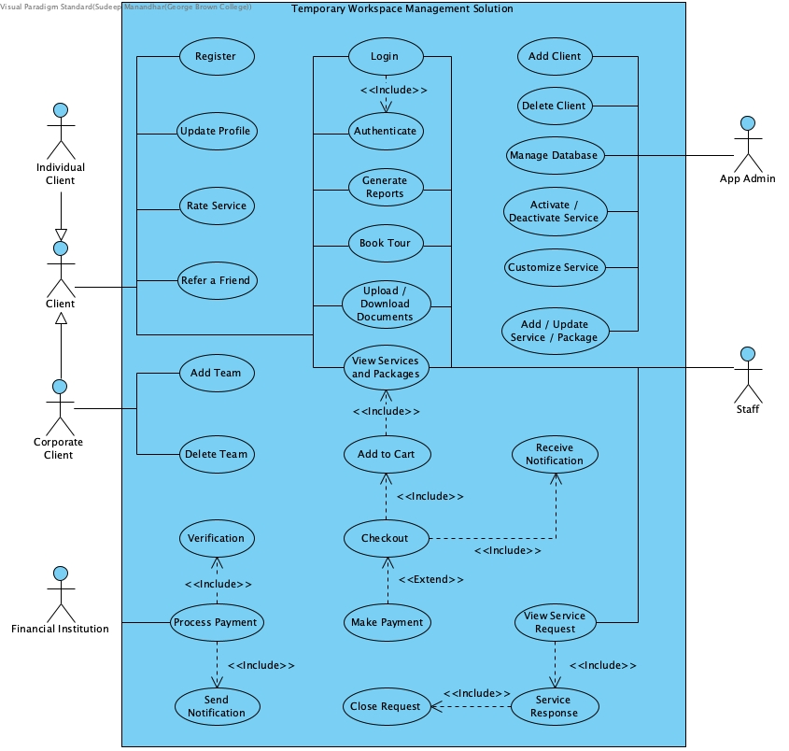
USE CASE DIAGRAM

Slide 10
DATA MODEL DIAGRAM

Slide 11
Project requirements
Kamrun Nahar Liza

Slide 12
FUNCTIONAL REQ
Login
Various access level based on user type
CRUD operations (+enable / disable)
Staff/Admin: Packages, Services, Workspace, Users
Notifications
Transaction, Request Confirmation / Closure, Payment Reminders
Payments

Slide 13
FUNCTIONAL REQ
Service Requests
Client: View/Make requests
Staff/Admin: Process requests
Book a Tour
Documents Upload / Download
Ratings
Clients may rate the services and provide review

Slide 14
NON-FUNCTIONAL REQ
The system response time
Optimum browsing conditions: not more than 2 seconds
Average condition: 3-5 seconds
Reliable, relevant and consistent results
All conditions, inputs and times
Availability
24/7 per week
User security
Authorization of users
Authentication of login attempts

Slide 15




TECH REQUIREMENTS
Adds efficiency in coding
Easier to understand the concepts and implementation
Language
Frameworks
Team members familiar
Robust and well-documented
Can be used in both front-end and back-end

Slide 16



TECH REQUIREMENTS
Can implement free libraries
Modular (Easier to share contributions by all team members without any hassle.
Seamlessly compatible with popular browsers
Frontend
Better performance with medium transactions
Easy to design APIs
Can run on any popular OS
Backend

Slide 17


TECH REQUIREMENTS
Central repository
Flexibility, all members can work separately and merge when ready
In case of problems, we can rollback
Database
Team members’ proficiency
Easy to scale up or migrate
Better performance
Robust and well-documented
VCA

Slide 18



LEARNING PLAN
Team Member | Responsibility | Existing Skill Level
Kamrun Nahar Liza | Product Owner Back-End
Sudeep Manandhar | Scrum Master Front-End
Rajesh Bista | Front-End
Suvash Sharma | Back-End
Shishir Das | Back-End Quality Control
Plan:
Take short online courses with focus on respective responsibilities
Share the learnings with the team to support integration
Timeline:
Focused Learning
18 Dec 2020 - 09 Jan 2021
Parallel Learning
09 Jan 2021 - 02 Apr 2021
Resources:
Publisher Documentation
Online Training Sites (Udemy, YouTube, etc.)

Slide 19
Prototype
Rajesh Bista
Sudeep Manandhar

Slide 20
PROTOTYPE
https://www.figma.com/file/qHgWmUL14kWdFiBGaXhslW/Prototype

Slide 21
Prototype

